Slide 1




Detecting Duplicate Questions and Generating Answers with ChatGPT
Presenters
Abdul Rafay 21-NTU-CS-1197
Arooba Zaman 21-NTU-CS-1211

Slide 2

Agenda
Topics Covered
Problem Statement
Data Set
Processing Steps
Features Extraction
EDA
Algorithms
Confusion matrix
Count Vectorizer

Slide 3

Problem Statement
Duplicate questions overwhelm online platforms, hindering search functionality and requiring automated, accurate detection solutions for improved user experience.

Slide 4
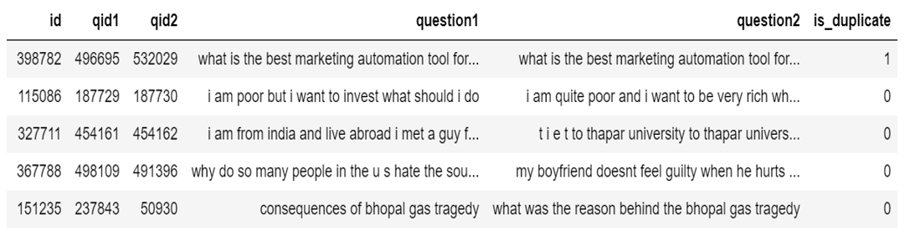
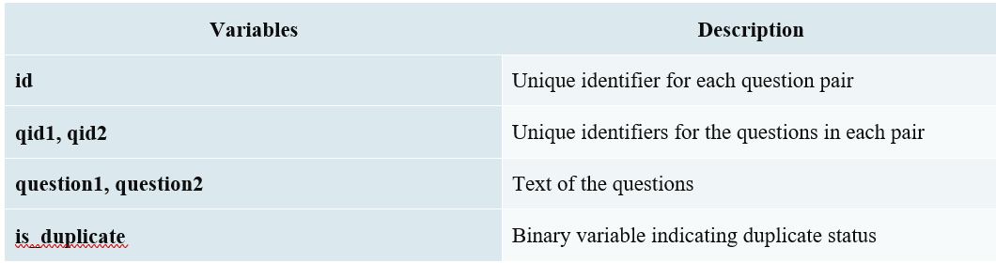
Data Set
The dataset, sourced from Quora on Kaggle, features labeled question pairs, perfect for training effective duplicate detection models. Total: 400,000 entries; 30,000 used for training.
Link: https://www.kaggle.com/c/quora-question-pairs/data

Slide 5
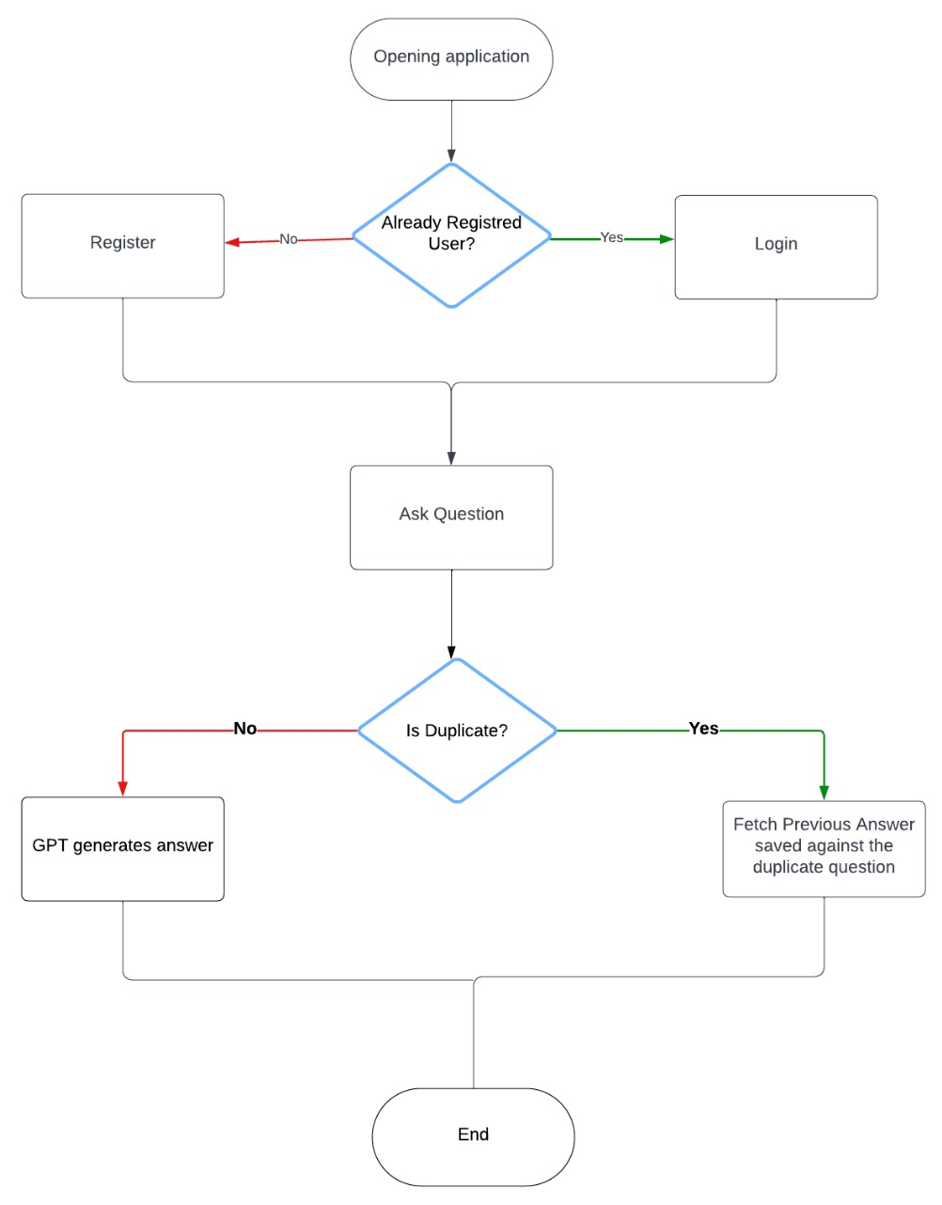
Flowchart of the WorkFlow
Yes
No

Slide 6


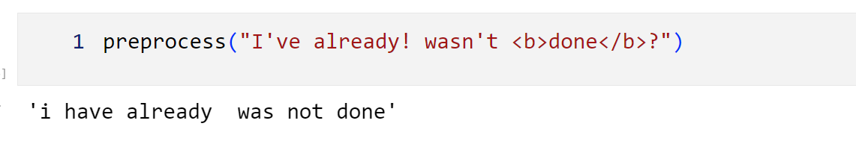

Pre-Processing Technique
Lowercasing and Stripping
Replacing Special Characters
Removing Unnecessary Patterns
Replacing Large Numbers with String Equivalents
Decontracting Words
Removing HTML Tags

Slide 7
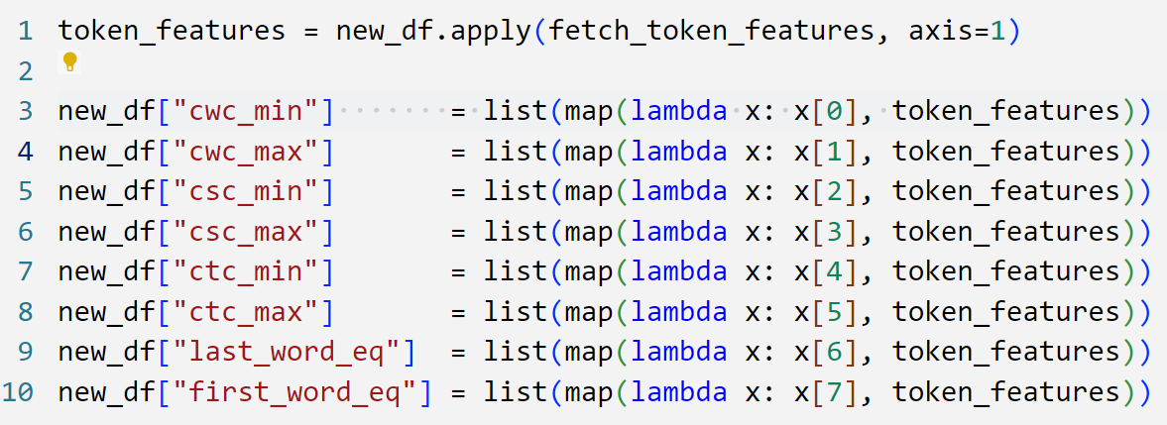
Feature Engineering
Basic Features
Length of Each Question
Number of Words in Each Question
Common Words
Total Words
Advanced Features
Token Features
Length Features
Fuzzy Features

Slide 8
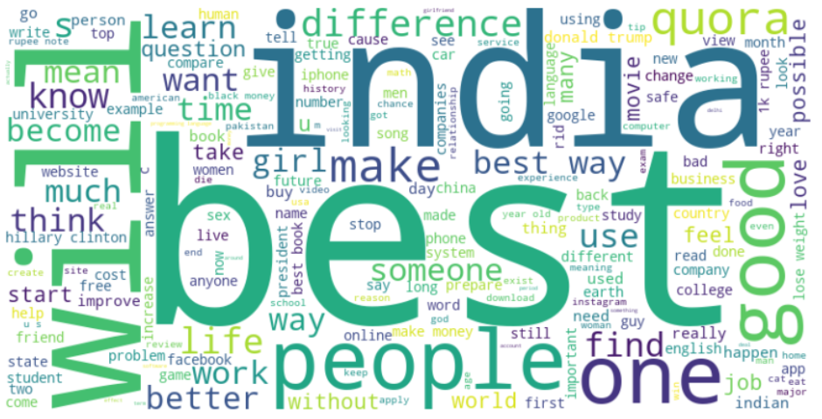
Word Cloud

Slide 9
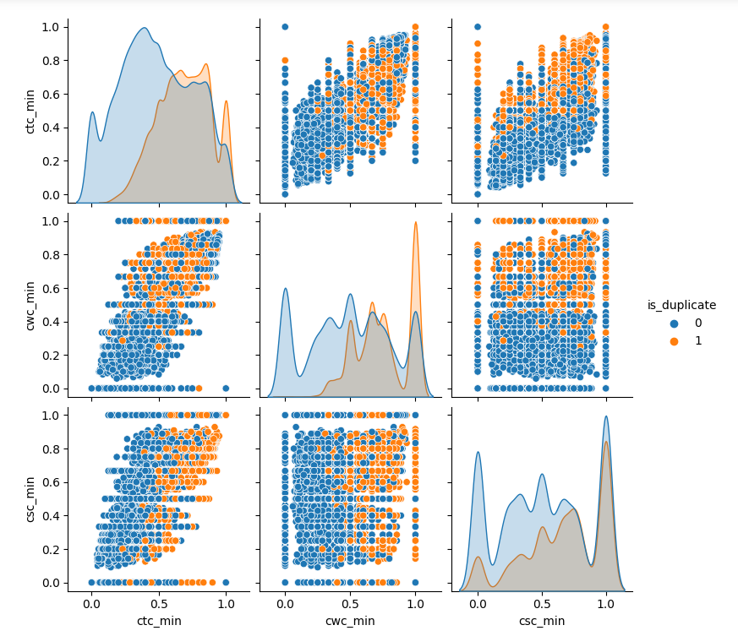
Exploratory Data Analysis (EDA)

Slide 10
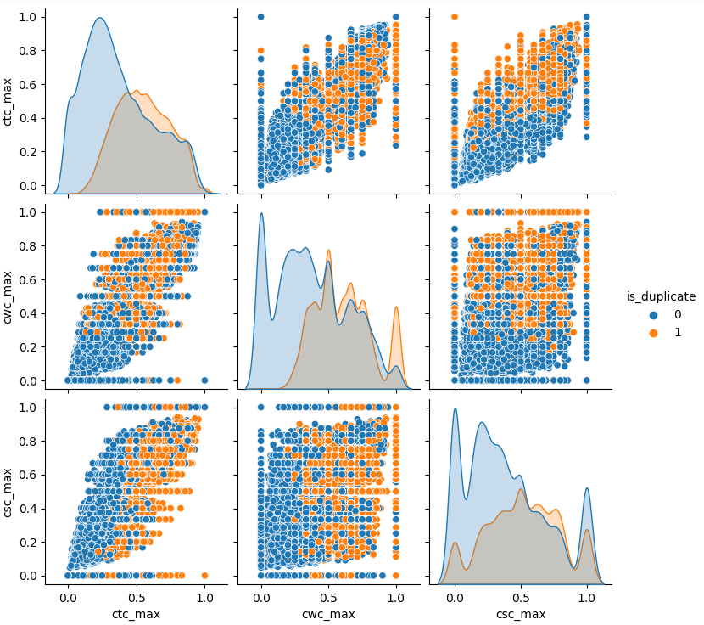
Exploratory Data Analysis (EDA)

Slide 11
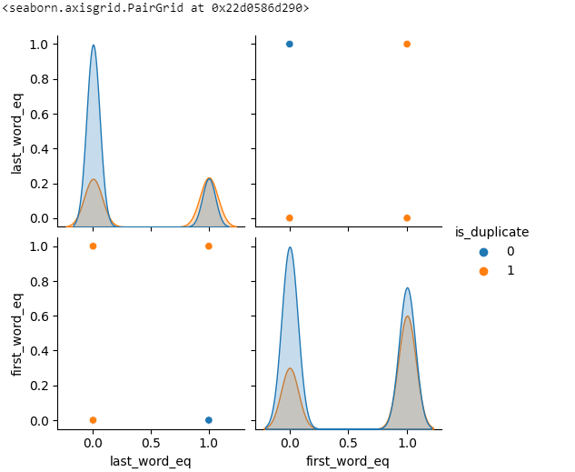
Exploratory Data Analysis (EDA)

Slide 12
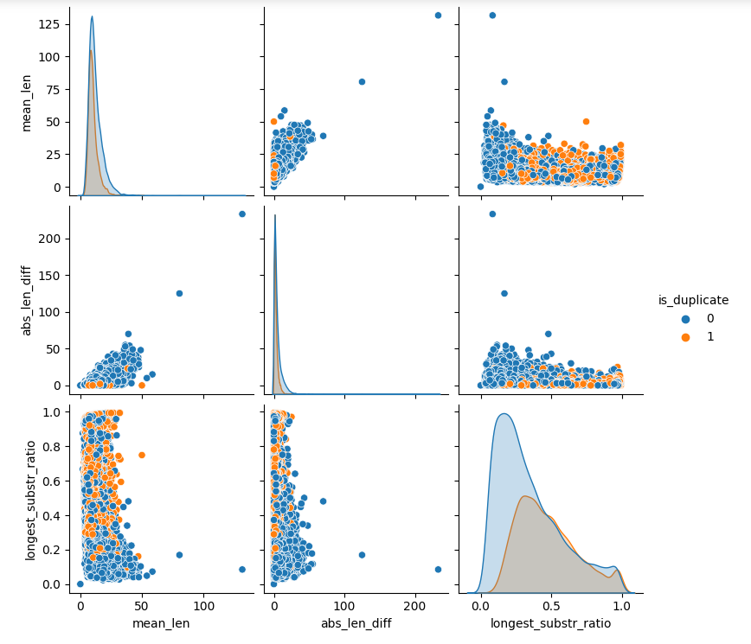
Exploratory Data Analysis (EDA)

Slide 13
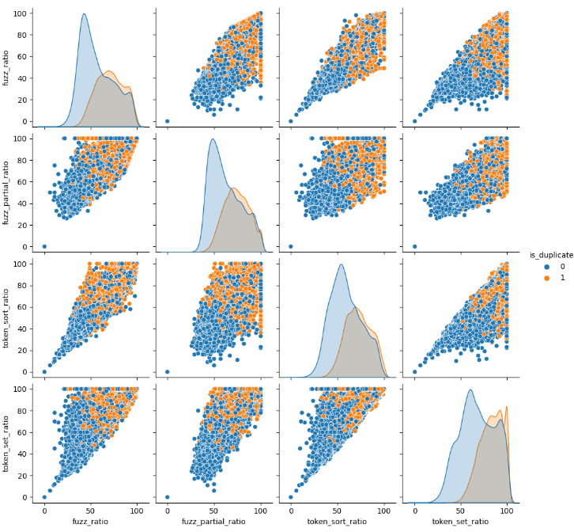
Exploratory Data Analysis (EDA)

Slide 14
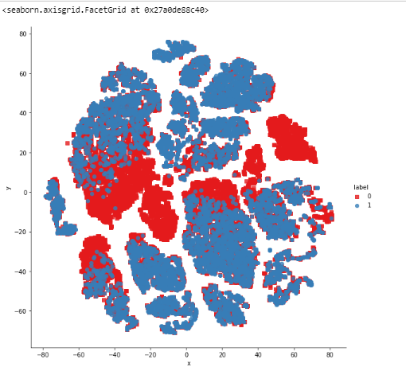
EDA – 2 Dimensional

Slide 15
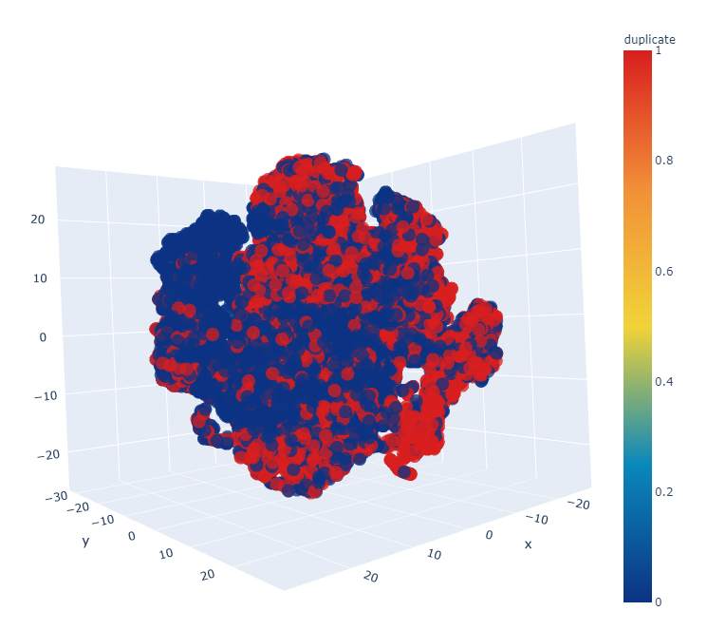
EDA – 3 Dimensional

Slide 16
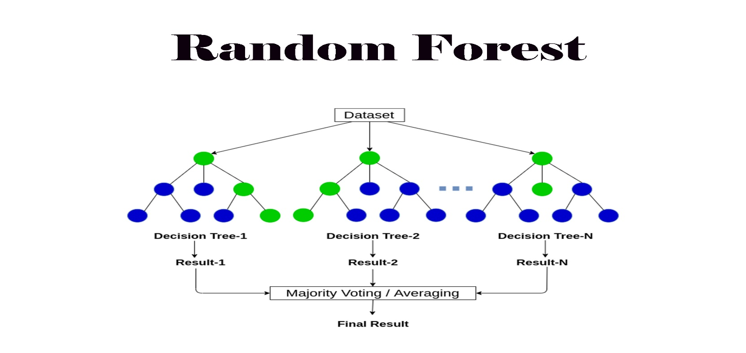
Algorithms
Random Forest:
For a classification problem, the final prediction is obtained by majority voting: y^=model{Tb(x)}b=1
For a regression problem, the final prediction is obtained by averaging the predictions: y^=1/B∑Tb(x)

Slide 17
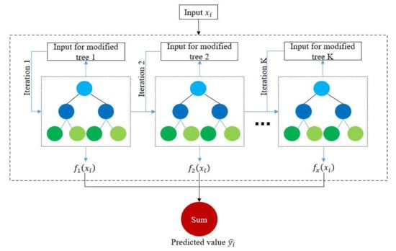
Algorithms
XGBoost:
The XGBoost algorithm works by iteratively building decision trees, optimizing for speed and performance in predictive modeling

Slide 18
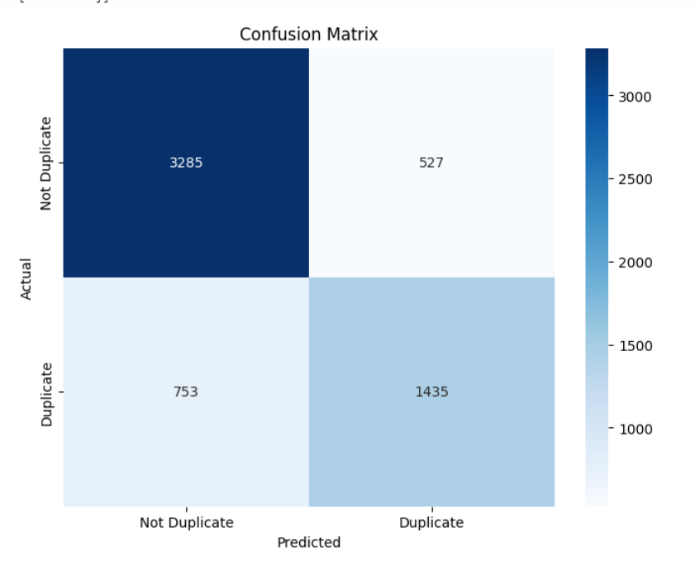
Confusion Matrix: Random Forest

Slide 19
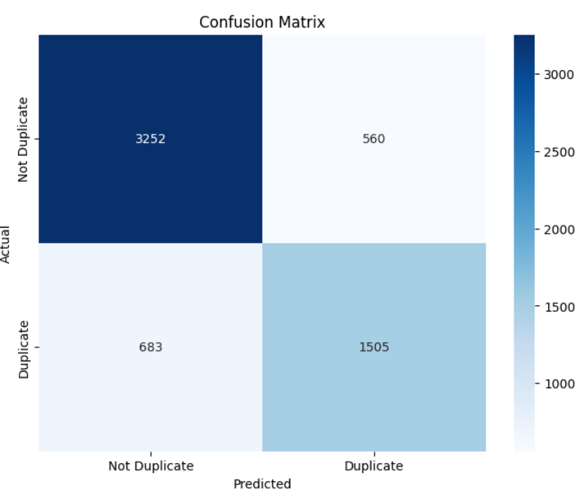
Confusion Matrix: XGBoost

Slide 20
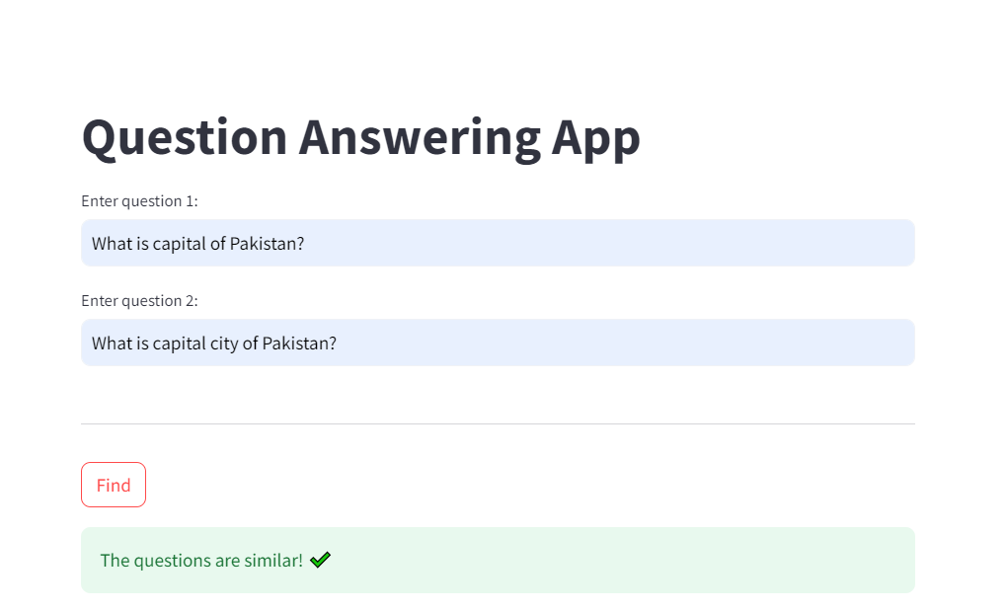
Streamlit – Application 01 Input and Output

Slide 21
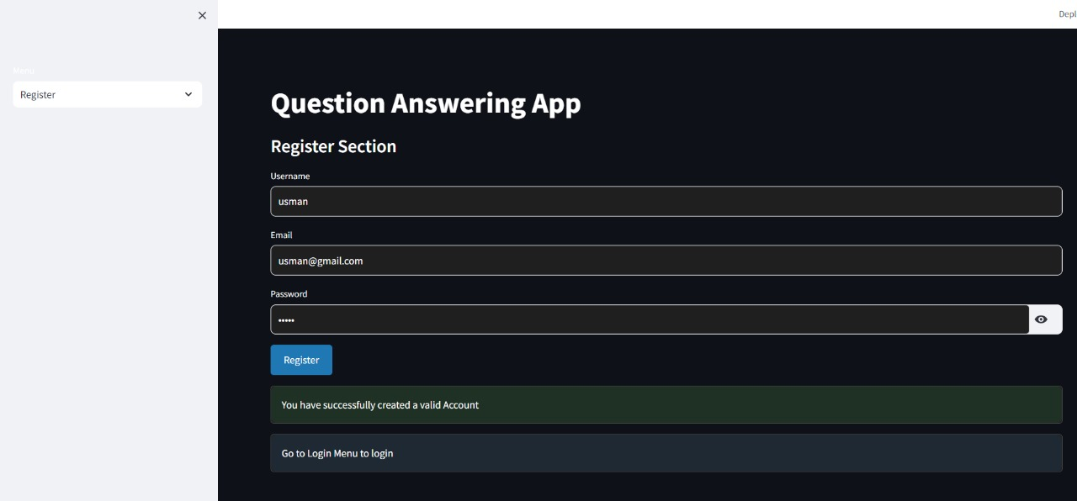
Streamlit – Application 02 Input and Output

Slide 22
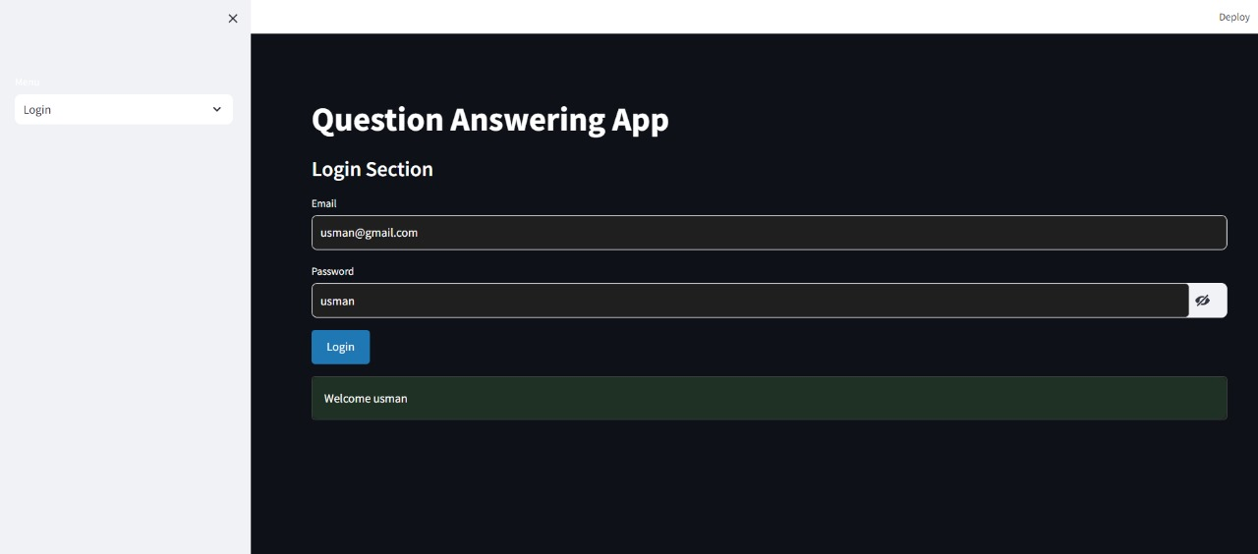
Streamlit – Application 02 Input and Output

Slide 23
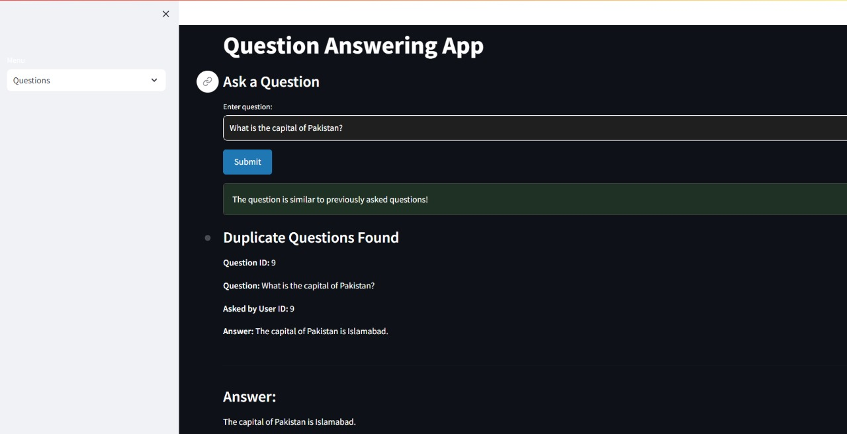
Streamlit – Application 02 Input and Output

Slide 24
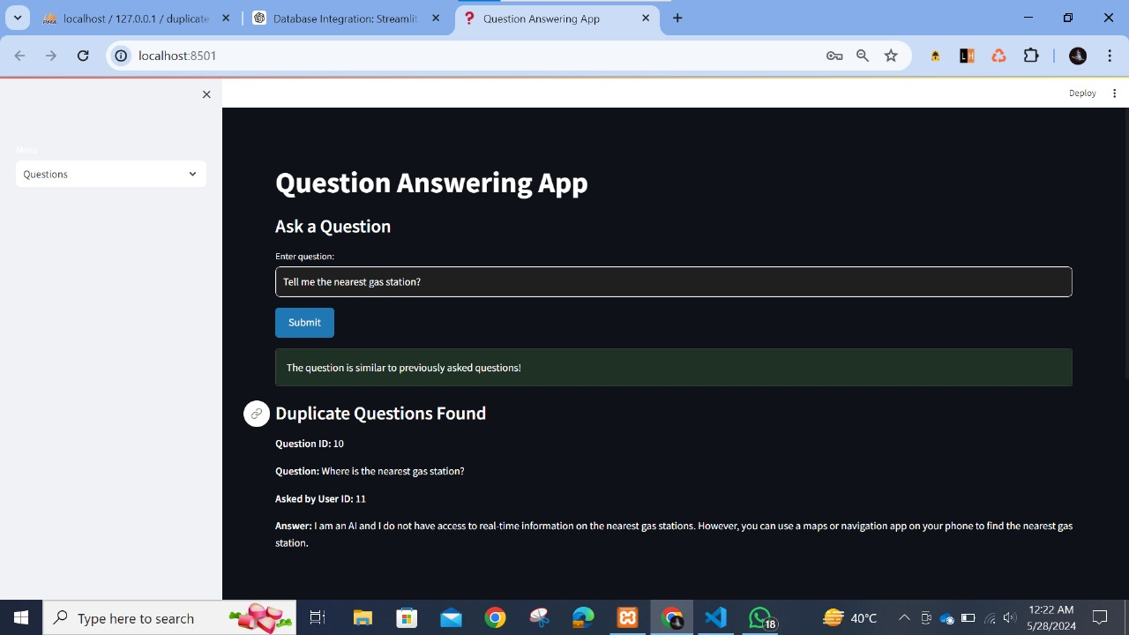
Streamlit – Application 02 Duplicate Questions

Slide 25
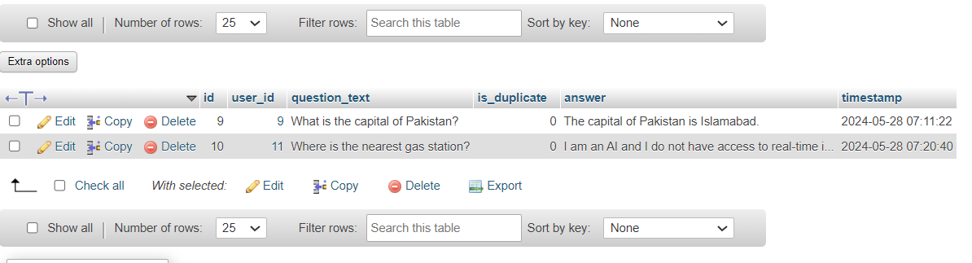
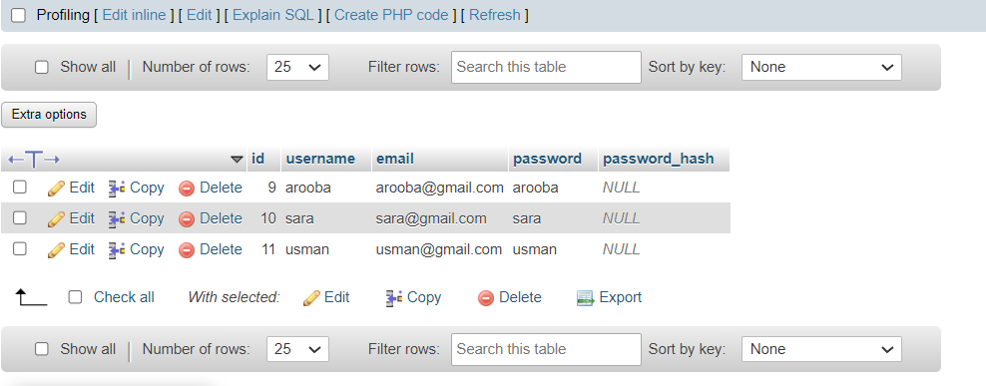
Database View

Slide 26
Thank you!
Feel Free to ask Questions

